Slide 1
GO FLIGHTS
Your Ultimate Flight Booking Solution
BY- RAHUL NAGARAJU

Slide 2

Secure Booking Safe Landing Your Journey, Our Commitment! - Go Flights

Slide 3
INTRODUCTION
Overview of Go Flights app
Aims to provide Effective Flight Bookings and Management

Slide 4
Key Features
User Authentication
Flight Search and Categorization
Booking Reservation
User Profile Management
Feedback and Support
Integration with External APIs

Slide 5
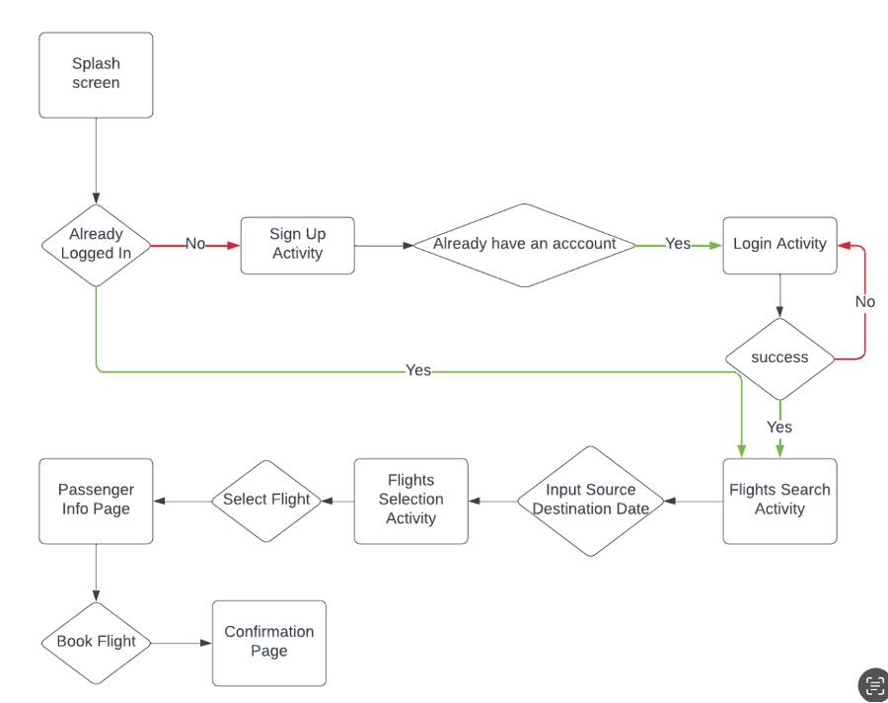
Flowchart

Slide 6
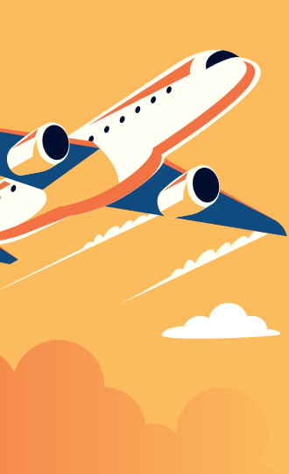
COMING UP! MOBLIE APP OVERLOOK

Slide 7
Snapshots!
Whoa ! So many Airlines and flights!

Slide 8
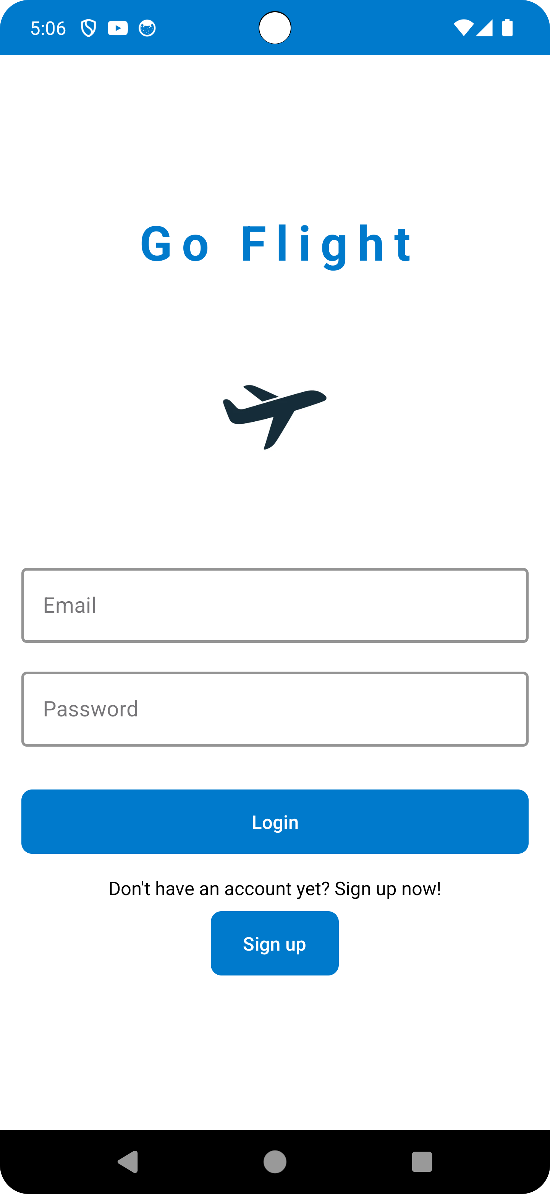
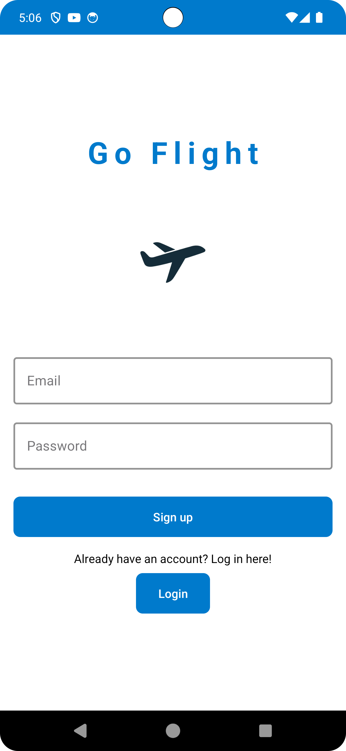
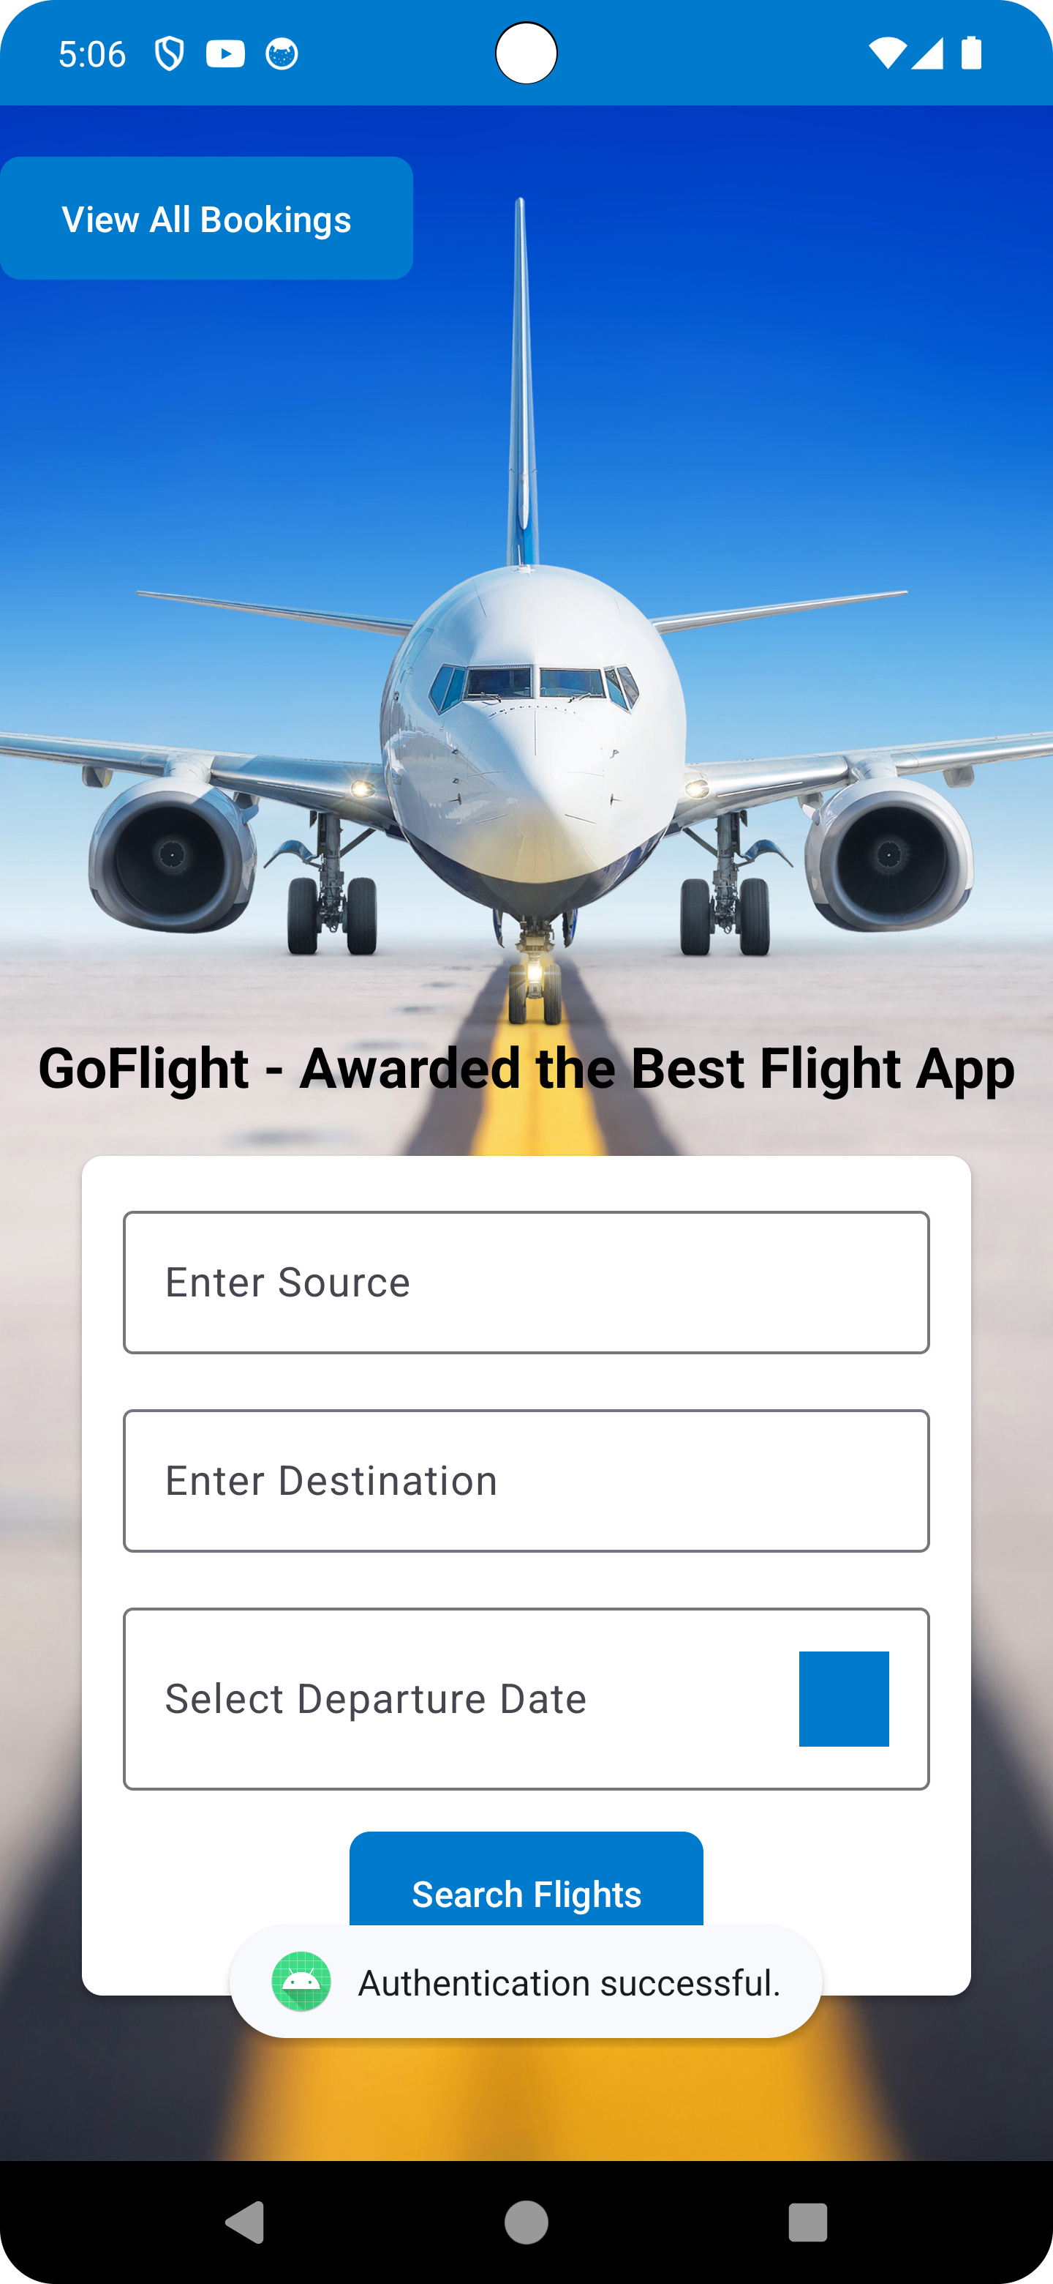
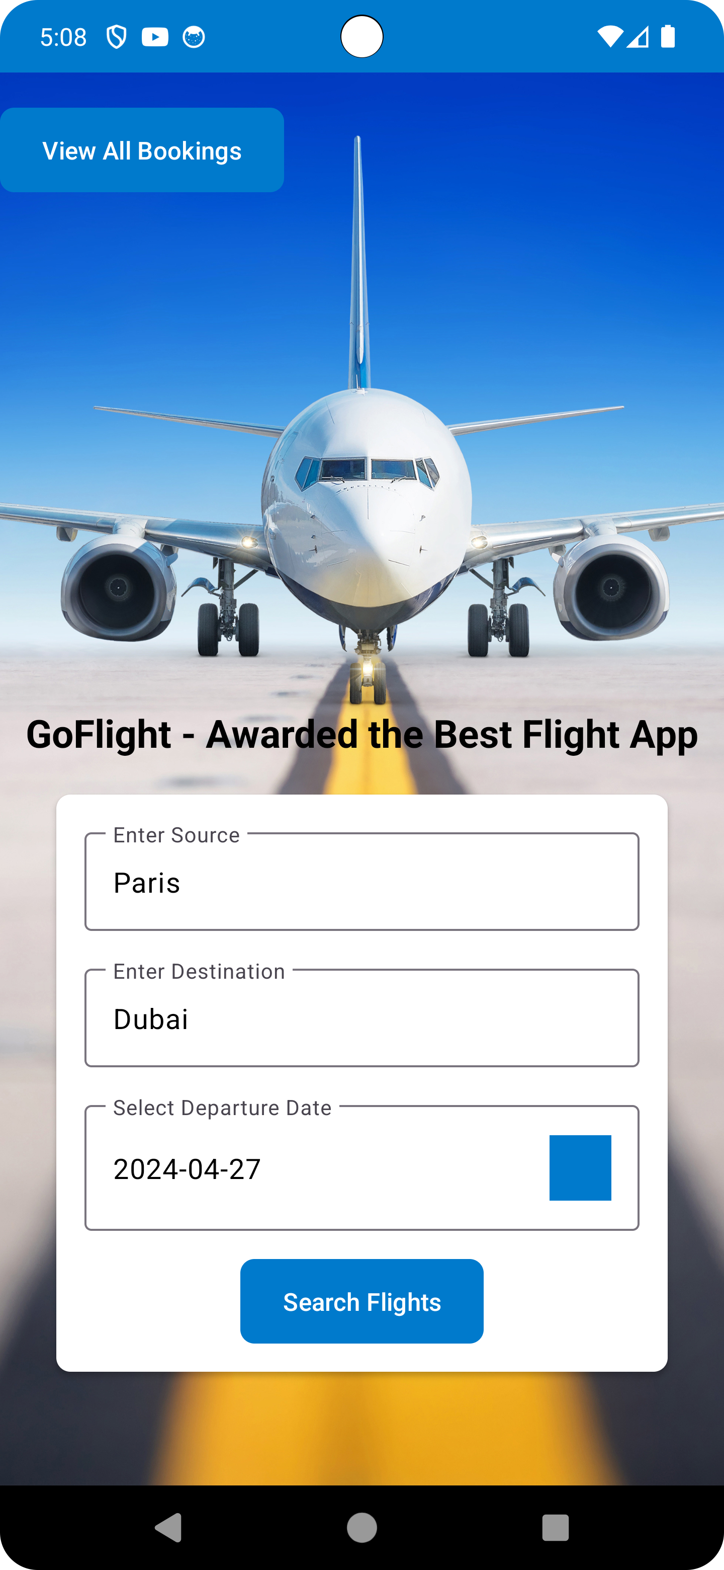

Slide 9
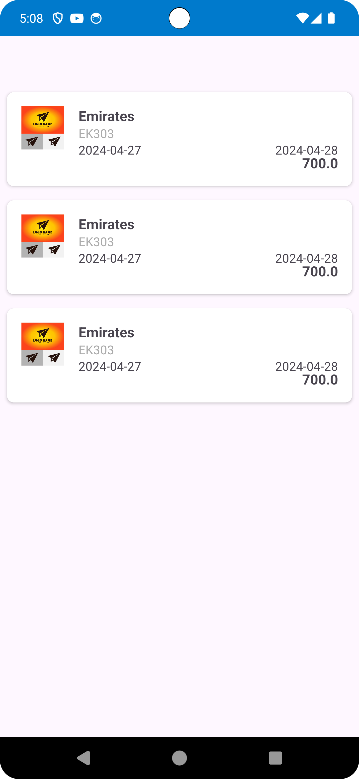
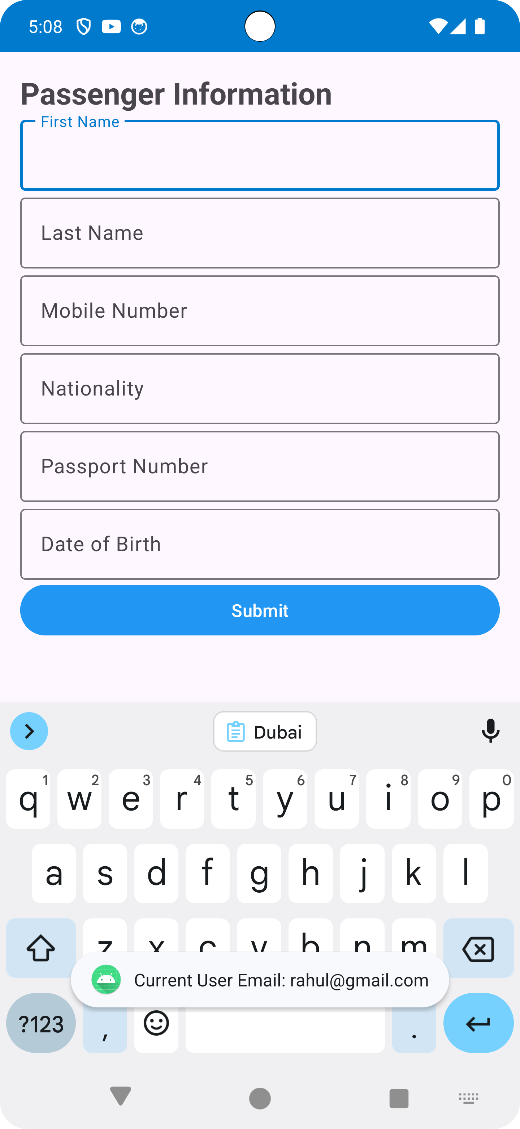
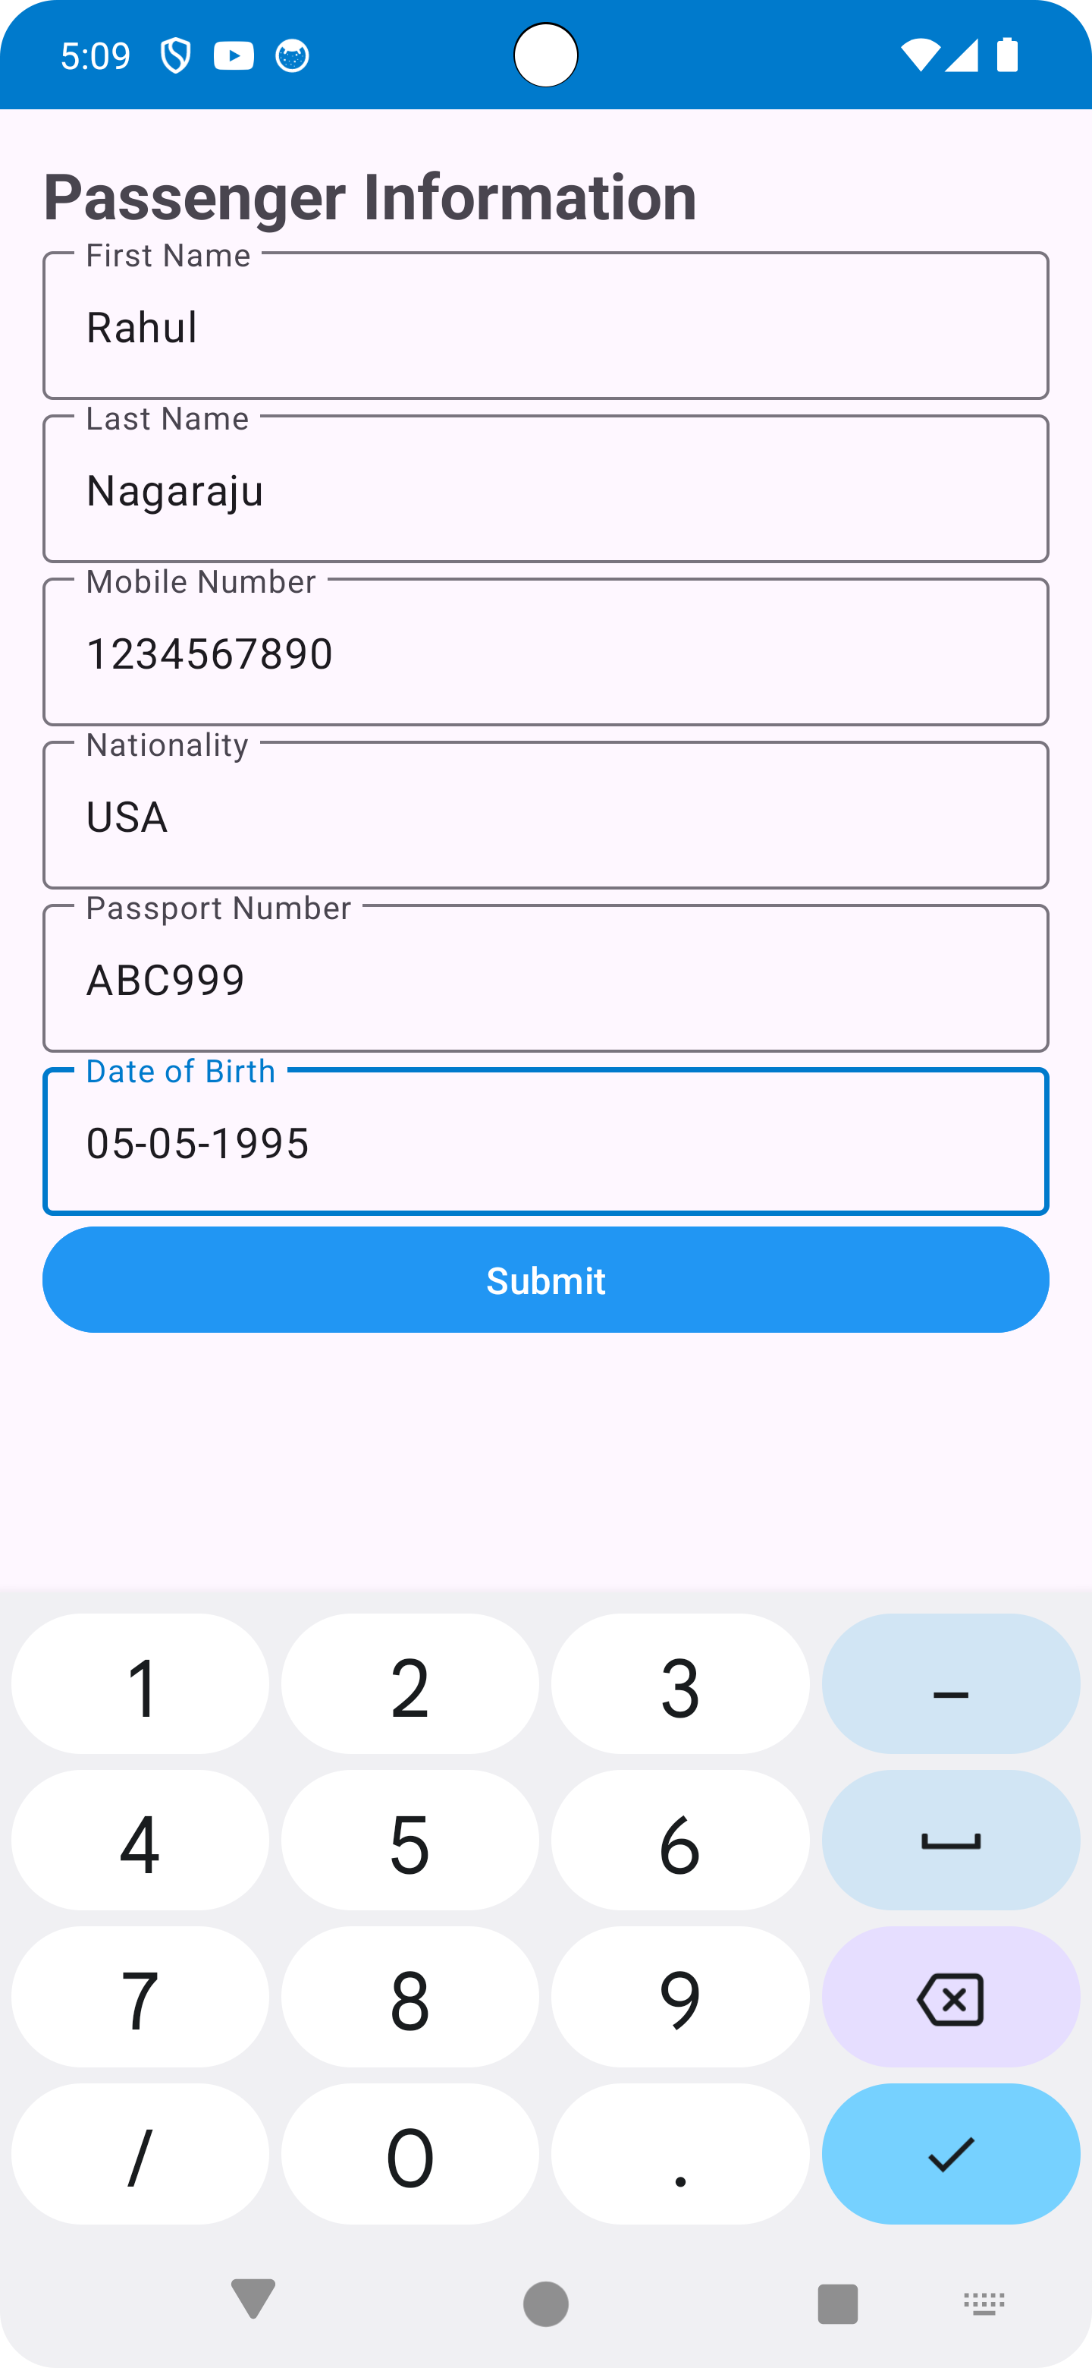
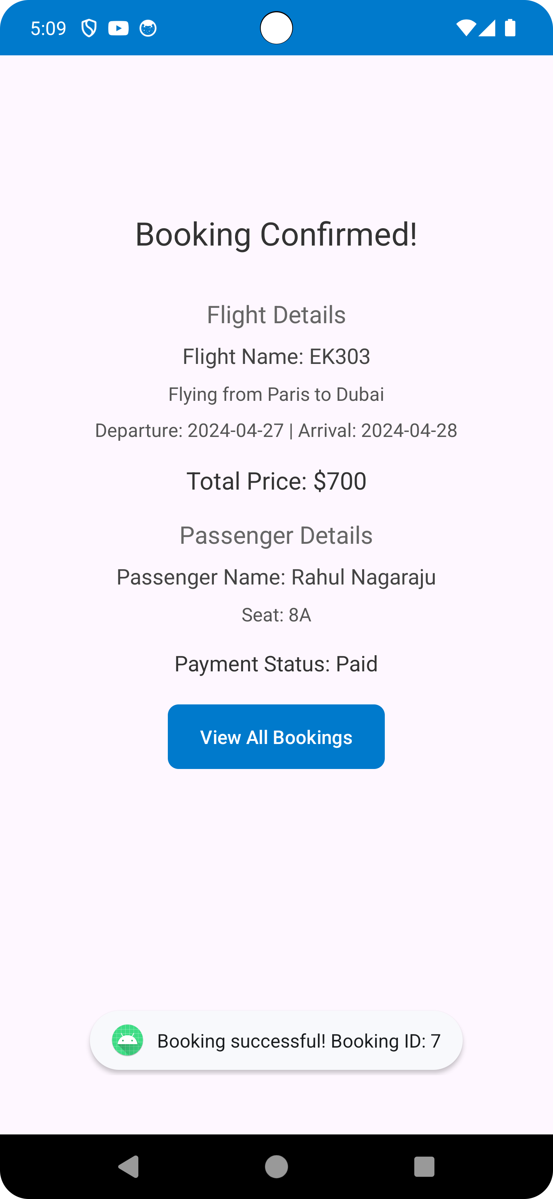

Slide 10
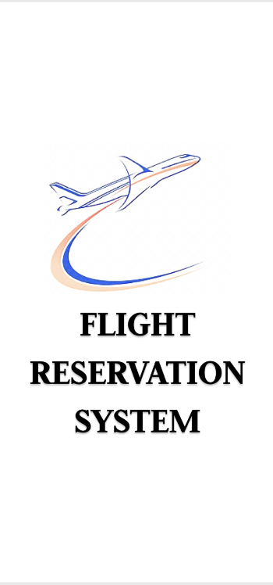
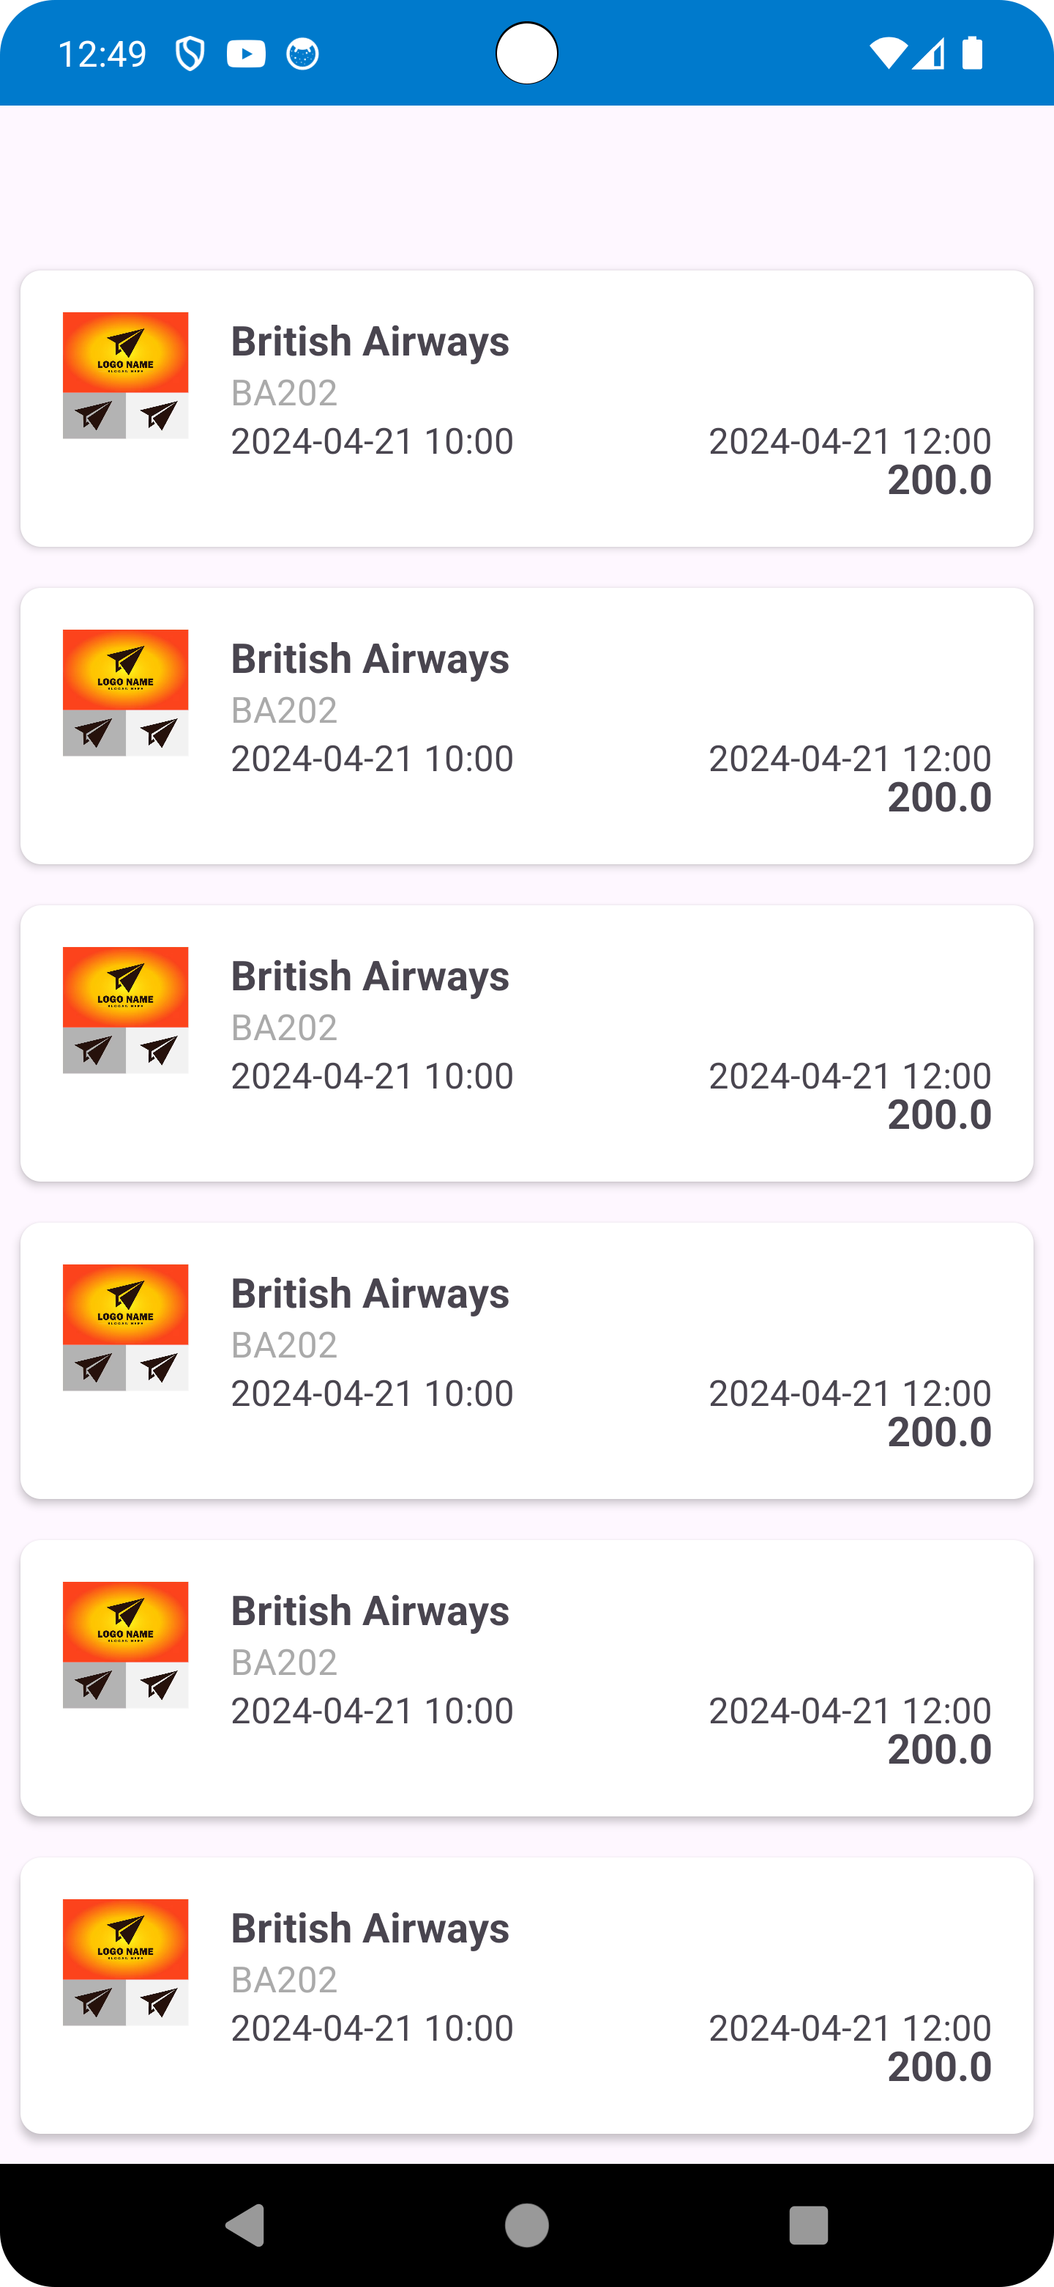
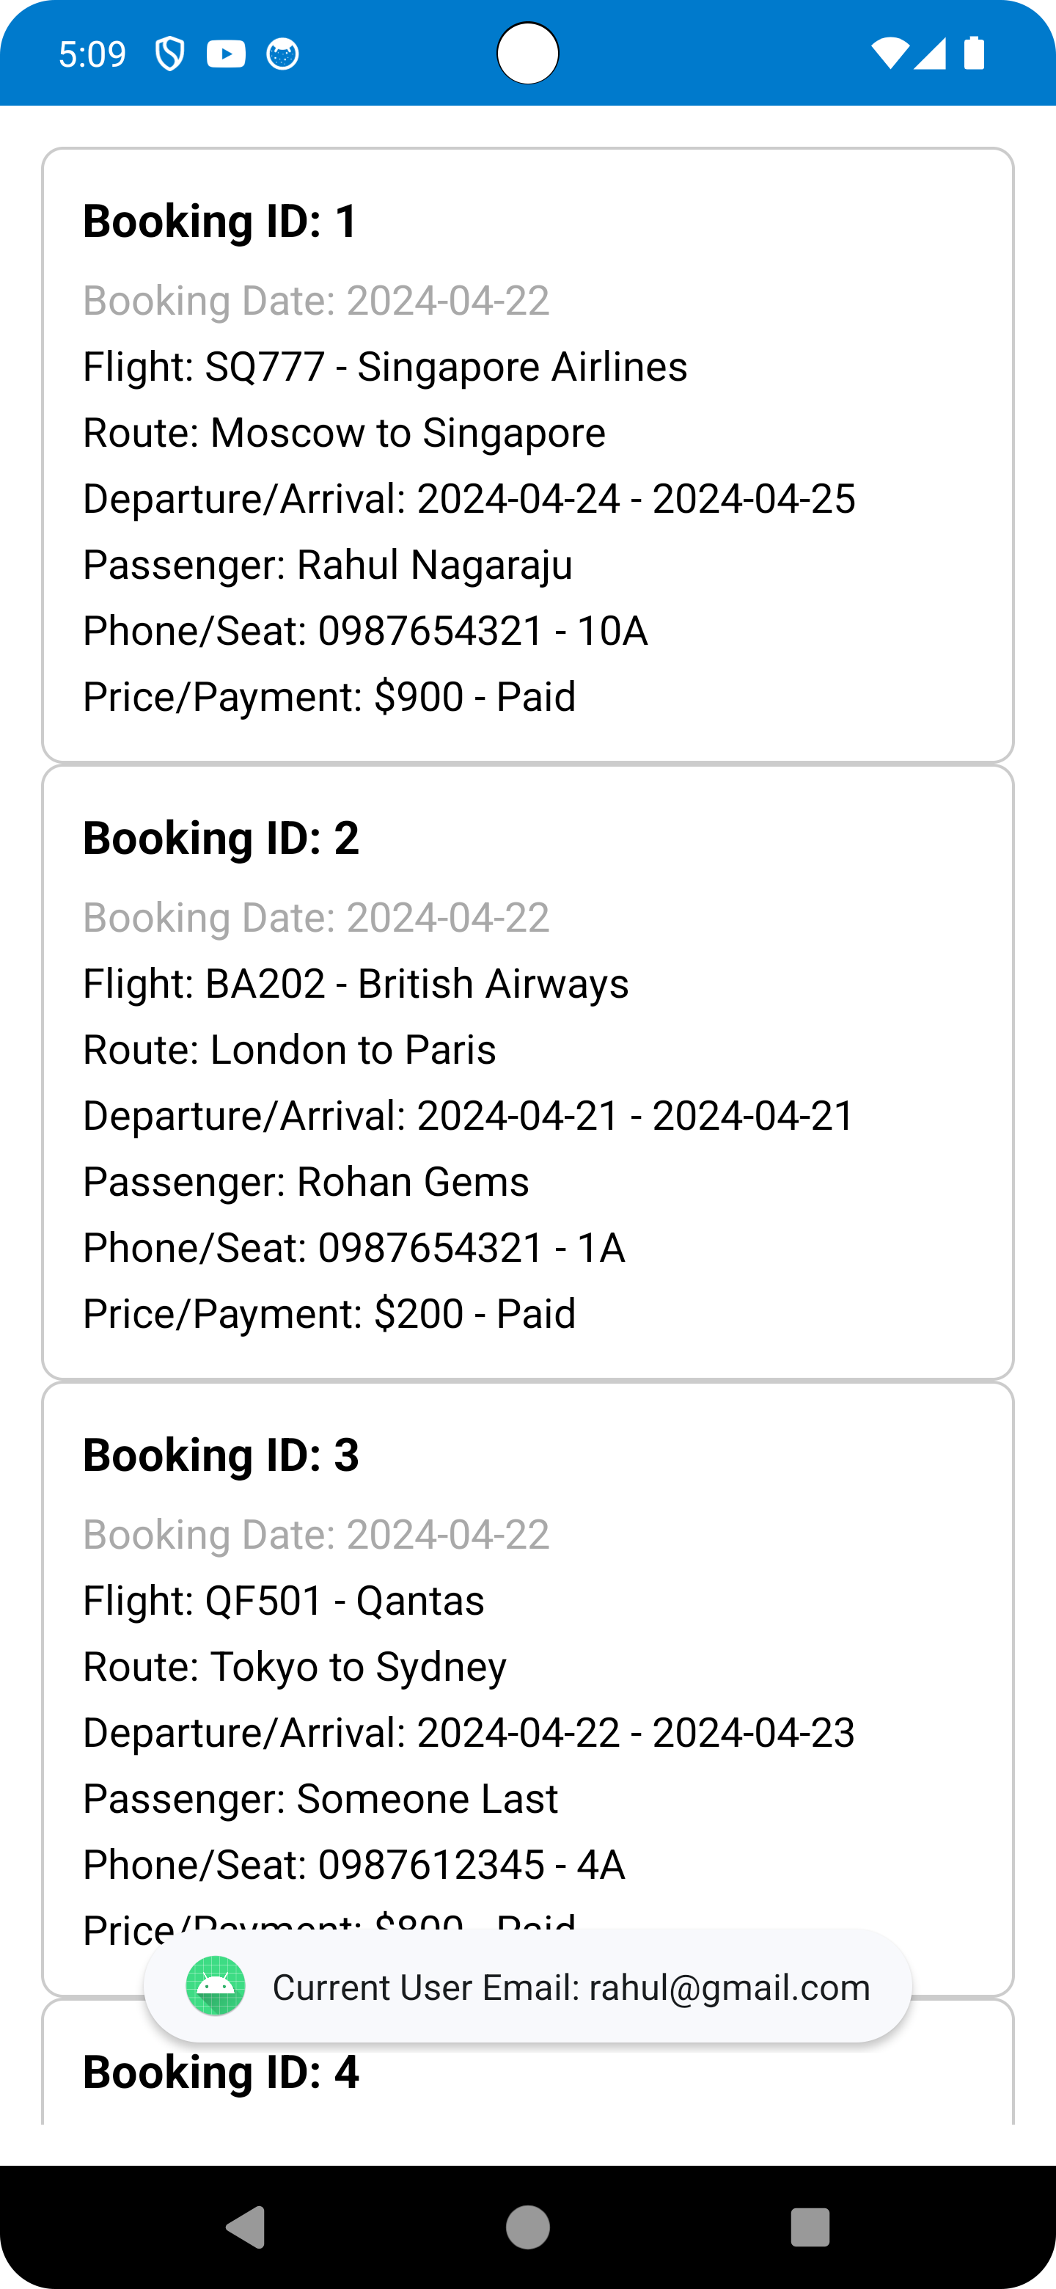
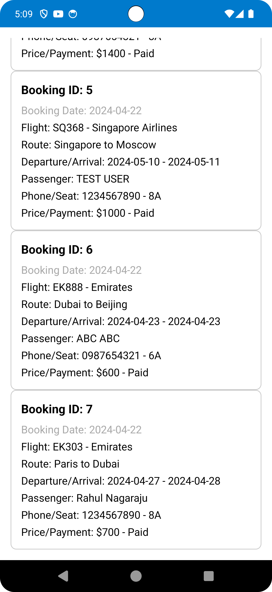

Slide 11
Problem Encountered
Working with Firebase
Push notifications
Email confirmation

Slide 12
Future Improvements
Multiple time zone support
Reservation detailed dashboard
Social media Login- Google, Facebook etc
Notifications when flights available

Slide 13
STATISTICS THIS YEAR
62+
3+
TRILLION
BILLION
XL
Passengers
Dollars in global GDP

Slide 14
CONCLUSIONS
Go Flights integrates Java code with user-friendly design to offer secure flight booking and efficient reservation management. With a focus on safety and enjoyment, we aim to redefine the travel experience for every user.

Slide 15
Thank you

Slide 16
Travel with Confidence Enjoy with Ease

